Slide 1
Chapter 2: Computer System
Memory

Slide 2
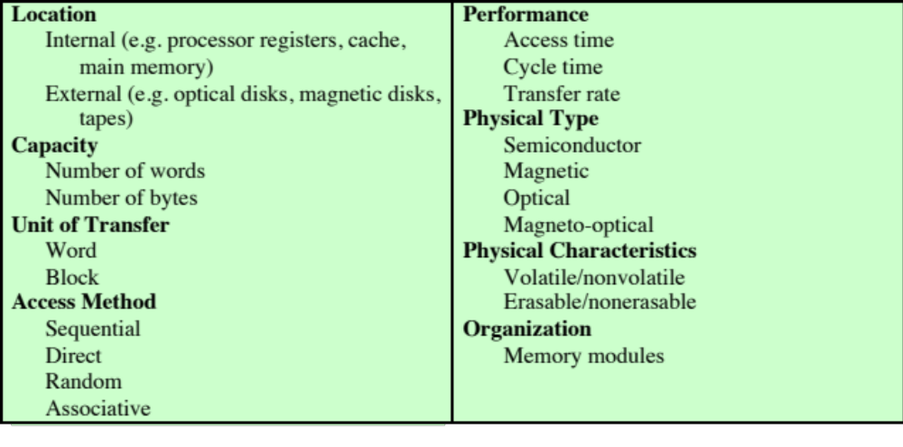
Key Characteristics of Computer Memory Systems

Slide 3
  Memory can either be volatile, nonvolatile,
  or nonerasable
The most common forms are:
  Semiconductor memory
  Magnetic surface memory
  Optical
  Magneto-optical

Slide 4
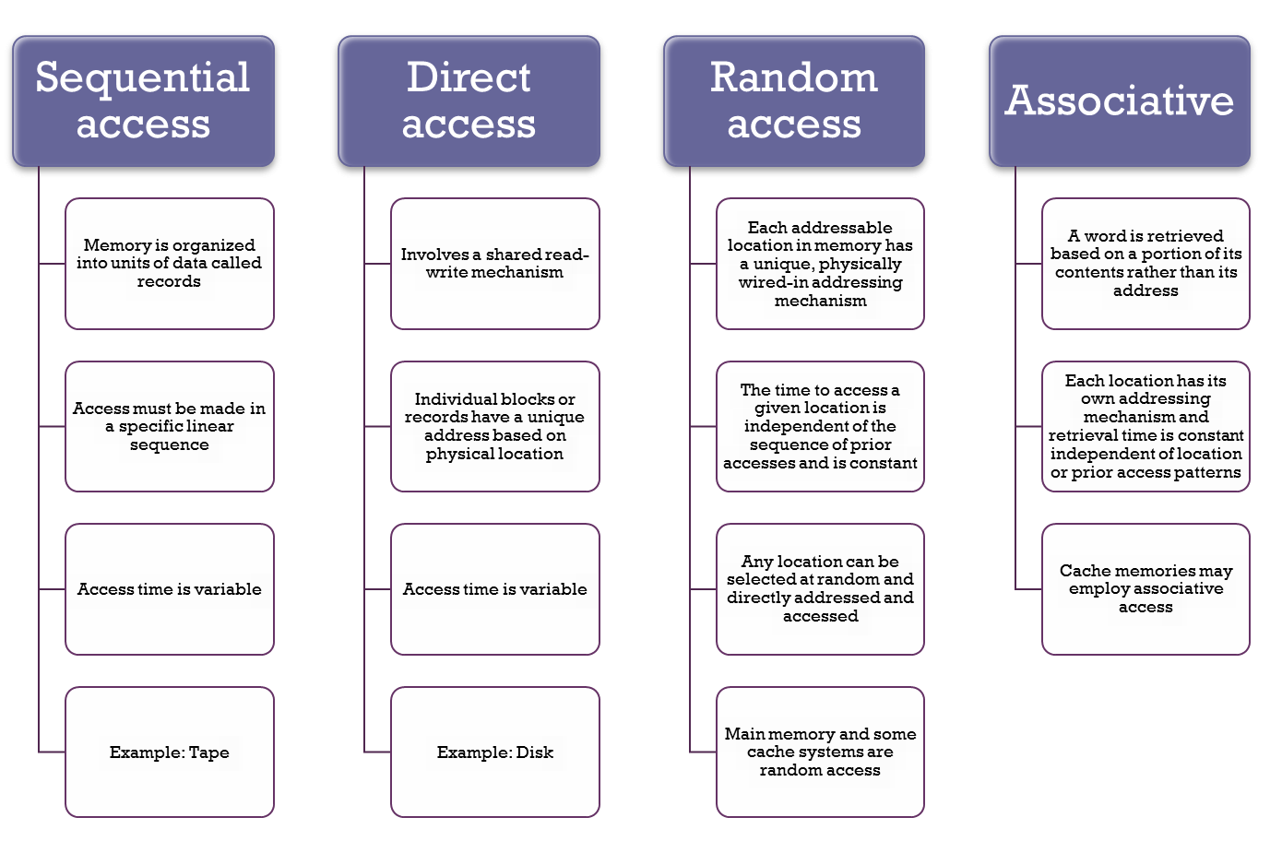
Method of Accessing Units of Data

Slide 5
What Users Care About
Performance
Capacity
Cost

Slide 6

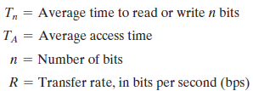
Performance
Three performance parameters influence performance:
Access time (latency)
Memory cycle time
Transfer rate

Slide 7
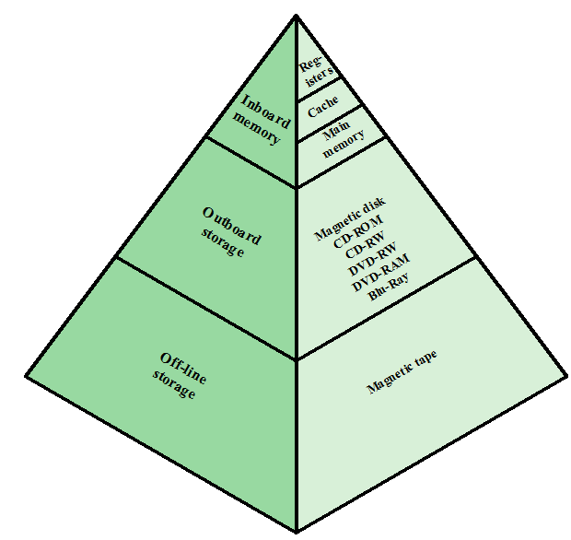
Memory Hierarchy

Slide 8
As we move from the top of the pyramid to the bottom we need:
  Decreasing cost per bit
  Increasing capacity
  Increasing access time
  Decreasing frequency of access of the memory by the processor

Slide 9
Semiconductor Main Memory

Slide 10
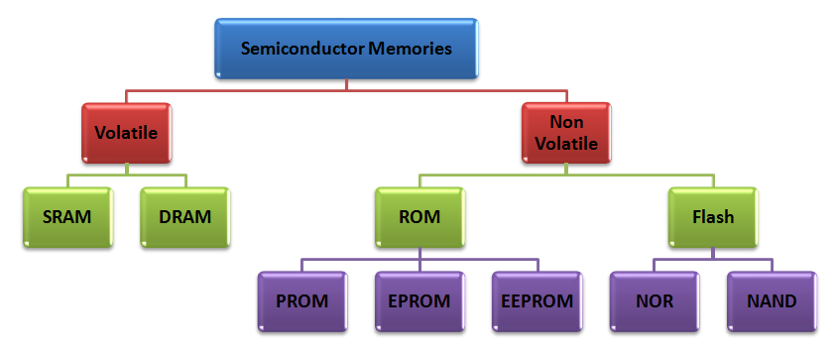
Semiconductor Memory Types

Slide 11
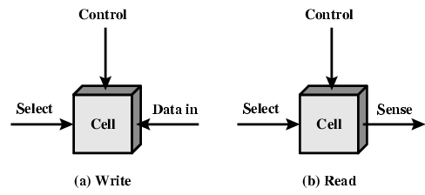
Memory Cell Operation

Slide 12
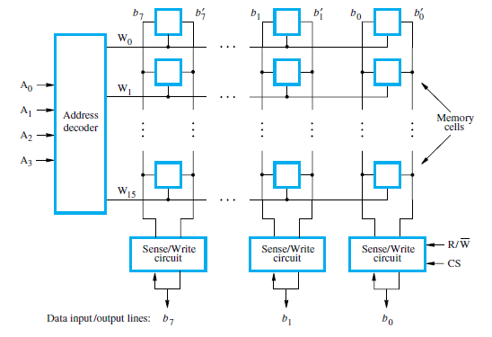
Organization of bit cells in a memory chip

Slide 13
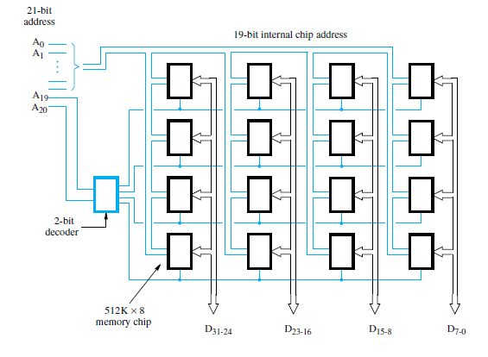
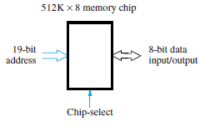
Organization of a 2M × 32 memory module using 512K × 8 static memory chips

Slide 14
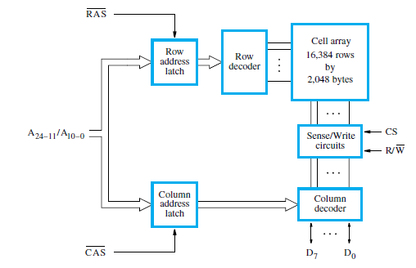
Internal organization of a 32M × 8 dynamic memory chip

Slide 15
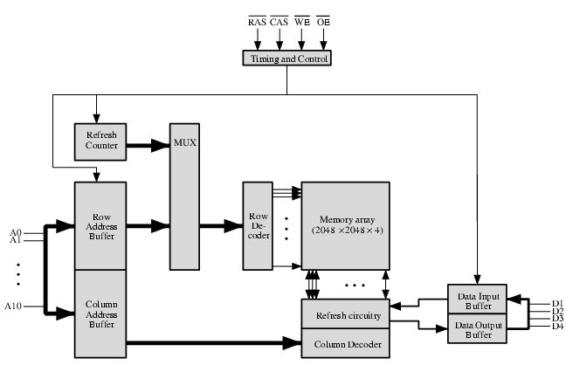
Typical 16 Mb DRAM (4M x 4)

Slide 16
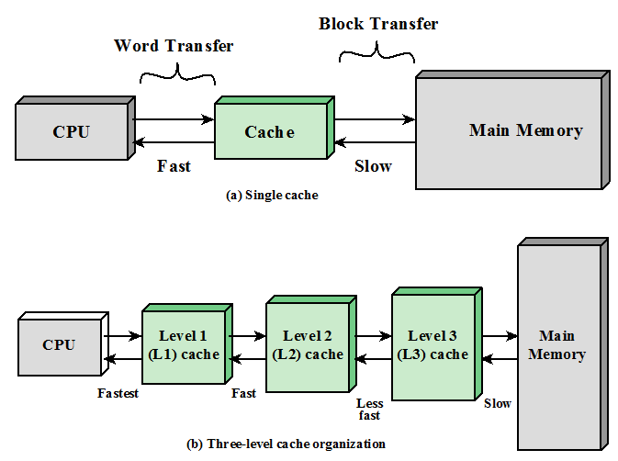
Cache Memory Principles

Slide 17
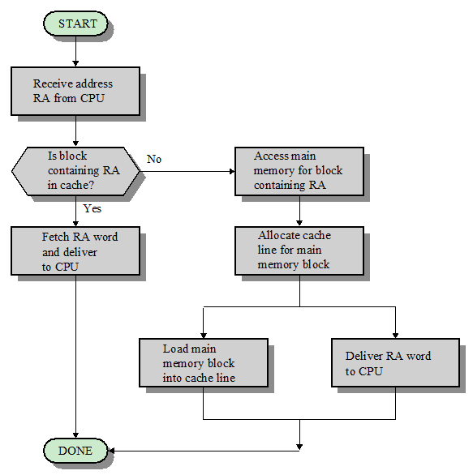
Cache Read Operation
RA→ Read Address

Slide 18
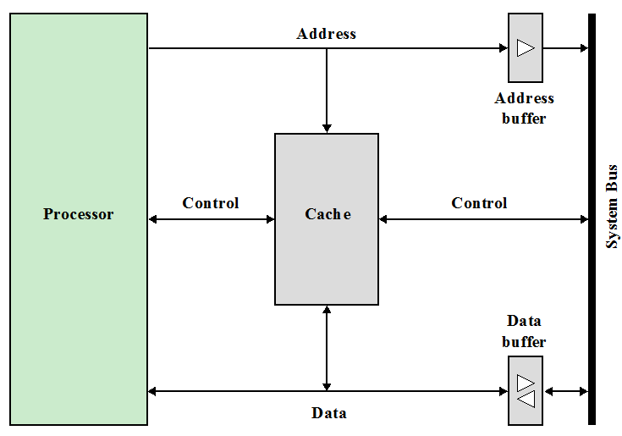
Typical Cache Organization

Slide 19
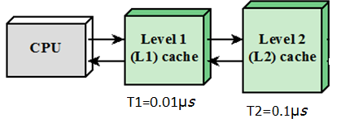
Example 1: Suppose that the processor has access to two levels of memory. Level 1
contains 1000 words and has an access time of 0.01 µs; level 2 contains 100,000 words and
has an access time of 0.1 µs. Assume 95% of the memory accesses are found in Level 1. Calculate the average time to access a word in memory.
Total Access time=
(0.95x.01 µs)+0.05(0.01 µs+0.1 µs)
=0.015 µs ͌ T1

Slide 20
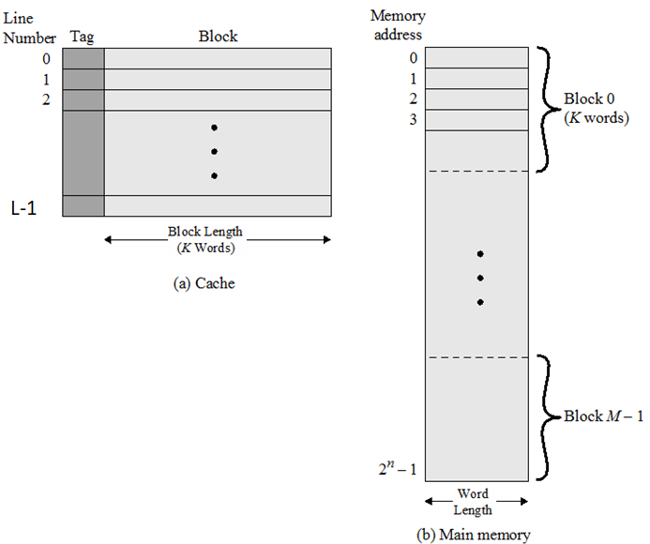
Cache/Main Memory Structure
M→ No. of main memory blocks
m→ No. of cache memory lines
**Note→ m<<M
K→ No. of words in each block/line

Slide 21
Mapping Function
Direct Mapping
Associative Mapping
Set-Associative Mapping

Slide 22

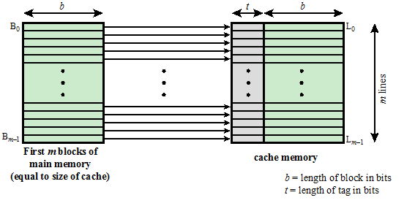
Direct Mapping

Slide 23
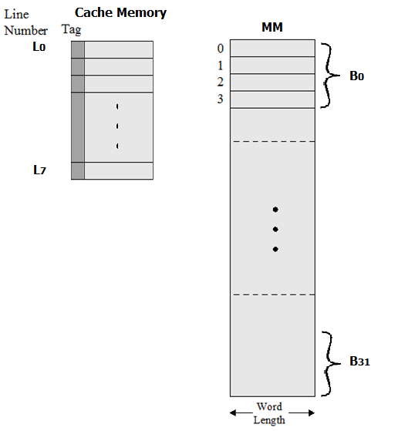
Consider an example :
Consider a main memory having 32 blocks of 4 words each
Cache memory having 8 Lines of words each

Slide 24
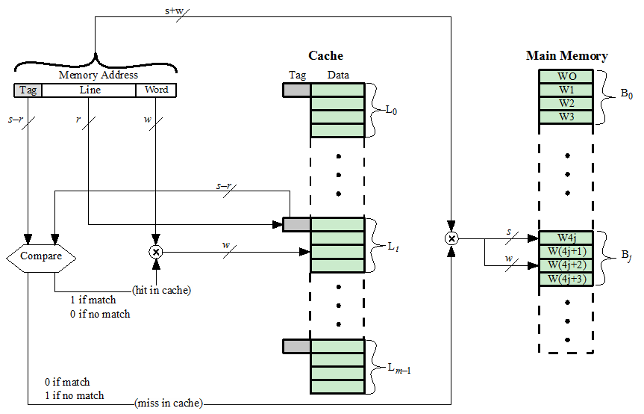
Direct- Mapping Cache Organization

Slide 25
Mapping of MM blocks(B_{j}) to cache lines(L_{i}) for Direct mapping
Address length = (s + w )= (5 + 2 ) bits
Number of addressable units = 2^{s+w} = 2⁵⁺² words or bytes
Block size = line size = 2^{w} = 2² =4 words or bytes
Number of blocks in main memory = 2^{s+w}/2^{w} = 2^{s}
=2⁵⁺²/2² = 2⁵ =32 Blocks
Number of lines in cache = m = 2^{r} =2³ =8
Size of cache = 2^{r+w} = 2³⁺² words or bytes
Size of tag = (s - r ) bits= (5 - 3 )= 2 bits
Tag bits→ | 00 | 01 | 10 | 11
L₀ | B₀ | B₈ | B₁₆ | B₂₄
L₁ | B₁ | B₉ | B₁₇ | B₂₅
L₂ | B₂ | B₁₀ | B₁₈ | B₂₆
L₃ | B₃ | B₁₁ | B₁₉ | B₂₇
L₄ | B₄ | B₁₂ | B₂₀ | B₂₈
L₅ | B₅ | B₁₃ | B₂₁ | B₂₉
L₆ | B₆ | B₁₄ | B₂₂ | B₃₀
L₇ | B₇ | B₁₅ | B₂₃ | B₃₁
Tag | Line | Word
2 | 3 | 2
i= j modulo m
Tag | Line | Word
10 | 101 | 10
Ex:
i→cache line no.
j→MM block no.
m→no. of lines in cache

Slide 26
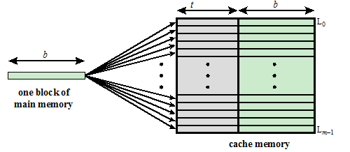
Fully-Associative Mapping

Slide 27
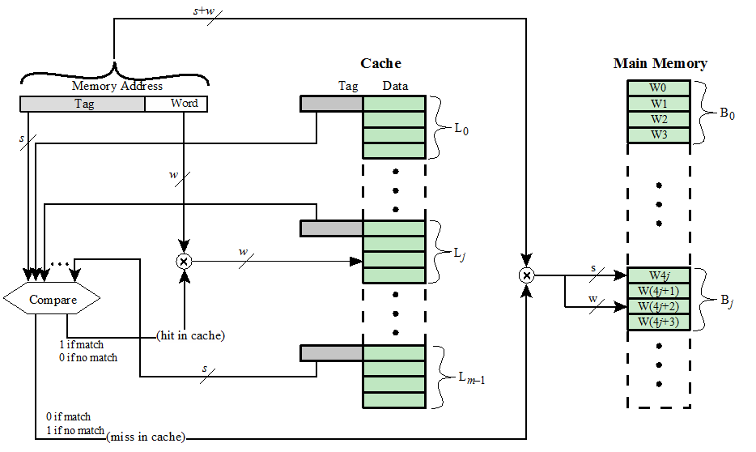
Fully Associative Cache

Slide 28
Mapping of MM blocks(B_{j}) to cache lines(L_{i}) for Associative mapping
Tag bits→ | 00000---→11111
L₀ | B₀-------B₃₁
L₁ | B₀-------B₃₁
L₂ | B₀-------B₃₁
L₃ | B₀-------B₃₁
L₄ | B₀-------B₃₁
L₅ | B₀-------B₃₁
L₆ | B₀-------B₃₁
L₇ | B₀-------B₃₁
The penalty with associative mapping is the cost of comparing a tag with every line in the cache
  To do this efficiently the cache must be small
Address length = (s + w) bits = 5 + 2 bits
Number of addressable units = 2^{s+w} words= 2³²
Block size = line size = 2^{w} words= 2² =4 words
Size of tag = s bits= 5 bits
Tag bits | Word bits
5 | 2
Tag bits | Word bits
11001 | 10
Ex:

Slide 29
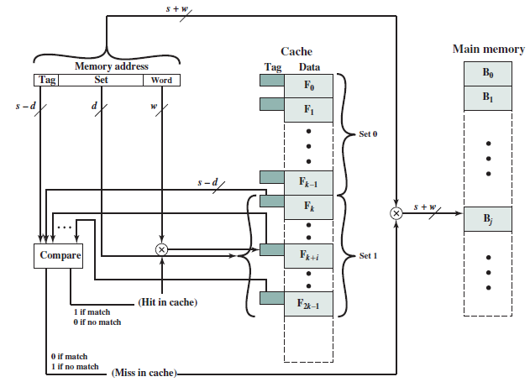
K- Way Set-Associative Cache Organization

Slide 30
2-Way Set Associative
S0
S1
S3
2 Lines per set
No. of sets=4 (from S₀ to S₃)

Slide 31
2- Way Set Associative
Set Bits | Tag bits→ | 000 | 001 | 010 | 011 | 100 | 101 | 110 | 111
00 | S₀ | B₀ | B₄ | B₈ | B₁₂ | B₁₆ | B₂₀ | B₂₄ | B₂₈
01 | S₁ | B₁ | B₅ | B₉ | B₁₃ | B₁₇ | B₂₁ | B₂₅ | B₂₉
10 | S₂ | B₂ | B₆ | B₁₀ | B₁₄ | B₁₈ | B₂₂ | B₂₆ | B₃₀
11 | S₃ | B₃ | B₇ | B₁₁ | B₁₅ | B₁₉ | B₂₃ | B₂₇ | B₃₁
i= j modulo v
No. of sets→4
No. of lines per set→ 2
i→cache set no.
j→MM block no.
v→no. of sets in cache
Tag | Set | Word
3 | 2 | 2
Tag | Set | Word
001 | 10 | 11
Ex:

Slide 32
Set Associative Mapping Summary
Address length = (s + w) bits = (5+2) bits
Number of addressable units = 2^{s+w} words =2⁵⁺² words
Block size = line size = 2^{w} = 2²=4 words or bytes
Number of lines in set = k= 2
Number of sets = v = 2^{d}= 2²
Number of lines in cache = m=kv = 2 x 4=8 lines
Size of cache = No. of sets x No. of lines per set x no. of words per line
=2^{d} * k * 2^{w} words or bytes
=4 * 2* 2=16 words
Size of tag = (s – d) = 5-2=3 bits

Slide 33
Example 1 :
A set-associative cache consists of 64 lines, or slots, divided into four-line sets. Main memory contains 4K blocks of 128 words each. Show the format of main memory addresses.
No. of sets=No. of lines/No. of lines per set
=64/4= 16= 2⁴
No. of Main Memory Blocks= 4K= 4 x 1024= 2¹²
No. of Main Memory Locations= No. of blocks x No. of words per block
=2¹² x 2⁷ ⁼ 2¹⁹
No. of Address Lines= 19
No. of Words=128=2⁷
No. of Sets=2⁴
Tag | Set | Word
8 | 4 | 7

Slide 34
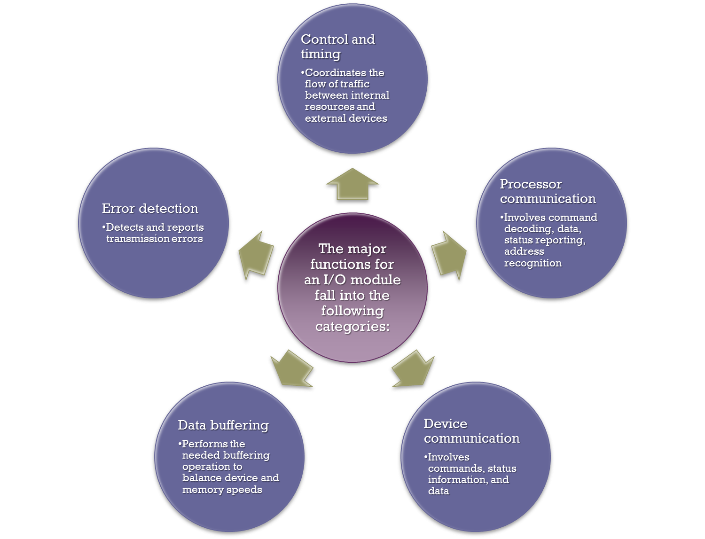
I/O Modules
Module Function
Notes:
The major functions or requirements for an I/O module fall into the following
categories:
• Control and timing
• Processor communication
• Device communication
• Data buffering
• Error detection
During any period of time, the processor may communicate with one or more
external devices in unpredictable patterns, depending on the program’s need for I/O.
The internal resources, such as main memory and the system bus, must be shared
among a number of activities, including data I/O. Thus, the I/O function includes a
control and timing requirement, to coordinate the flow of traffic between internal
resources and external devices. For example, the control of the transfer of data from
an external device to the processor might involve the following sequence of steps:
1. The processor interrogates the I/O module to check the status of the attached
device.
2. The I/O module returns the device status.
3. If the device is operational and ready to transmit, the processor requests the
transfer of data, by means of a command to the I/O module.
4. The I/O module obtains a unit of data (e.g., 8 or 16 bits) from the external device.
5. The data are transferred from the I/O module to the processor.
If the system employs a bus, then each of the interactions between the processor
and the I/O module involves one or more bus arbitrations.
The preceding simplified scenario also illustrates that the I/O module must
communicate with the processor and with the external device. Processor communication
involves the following:
• Command decoding: The I/O module accepts commands from the processor,
typically sent as signals on the control bus. For example, an I/O module for a
disk drive might accept the following commands: READ SECTOR, WRITE
SECTOR, SEEK track number, and SCAN record ID. The latter two commands
each include a parameter that is sent on the data bus.
• Data: Data are exchanged between the processor and the I/O module over the
data bus.
• Status reporting: Because peripherals are so slow, it is important to know the
status of the I/O module. For example, if an I/O module is asked to send data
to the processor (read), it may not be ready to do so because it is still working
on the previous I/O command. This fact can be reported with a status signal.
Common status signals are BUSY and READY. There may also be signals to
report various error conditions.
• Address recognition: Just as each word of memory has an address, so does
each I/O device. Thus, an I/O module must recognize one unique address for
each peripheral it controls.
On the other side, the I/O module must be able to perform device communication.
This communication involves commands, status information, and data
(Figure 7.2).
An essential task of an I/O module is data buffering. The need for this function
is apparent from Figure 2.11. Whereas the transfer rate into and out of main
memory or the processor is quite high, the rate is orders of magnitude lower for
many peripheral devices and covers a wide range. Data coming from main memory
are sent to an I/O module in a rapid burst. The data are buffered in the I/O module
and then sent to the peripheral device at its data rate. In the opposite direction, data
are buffered so as not to tie up the memory in a slow transfer operation. Thus, the
I/O module must be able to operate at both device and memory speeds. Similarly, if
the I/O device operates at a rate higher than the memory access rate, then the I/O
module performs the needed buffering operation.
Finally, an I/O module is often responsible for error detection and for subsequently
reporting errors to the processor. One class of errors includes mechanical
and electrical malfunctions reported by the device (e.g., paper jam, bad disk track).
Another class consists of unintentional changes to the bit pattern as it is transmitted
from device to I/O module. Some form of error-detecting code is often used
to detect transmission errors. A simple example is the use of a parity bit on each
character of data. For example, the IRA character code occupies 7 bits of a byte.
The eighth bit is set so that the total number of 1s in the byte is even (even parity)
or odd (odd parity). When a byte is received, the I/O module checks the parity to
determine whether an error has occurred.

Slide 35
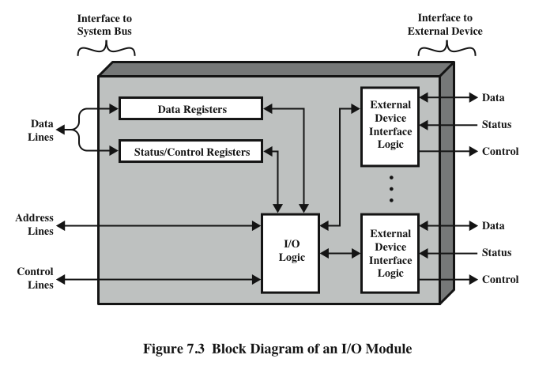
I/O Module Structure

Slide 36
Programmed I/O
Three techniques are possible for I/O operations:
Programmed I/O
  Data are exchanged between the processor and the I/O module
  Processor executes a program that gives it direct control of the I/O operation
  When the processor issues a command it must wait until the I/O operation is complete
  If the processor is faster than the I/O module this is wasteful of processor time
  Interrupt-driven I/O
  Processor issues an I/O command, continues to execute other instructions, and is interrupted by the I/O module when the latter has completed its work
  Direct memory access (DMA)
  The I/O module and main memory exchange data directly without processor involvement
Notes:
Three techniques are possible for I/O operations. With programmed I/O, data are
exchanged between the processor and the I/O module. The processor executes a program
that gives it direct control of the I/O operation, including sensing device status,
sending a read or write command, and transferring the data. When the processor
issues a command to the I/O module, it must wait until the I/O operation is complete.
If the processor is faster than the I/O module, this is wasteful of processor time.
With interrupt-driven I/O, the processor issues an I/O command, continues to execute
other instructions, and is interrupted by the I/O module when the latter has completed
its work. With both programmed and interrupt I/O, the processor is responsible for
extracting data from main memory for output and storing data in main memory for
input. The alternative is known as direct memory access (DMA). In this mode, the I/O
module and main memory exchange data directly, without processor involvement.

Slide 37
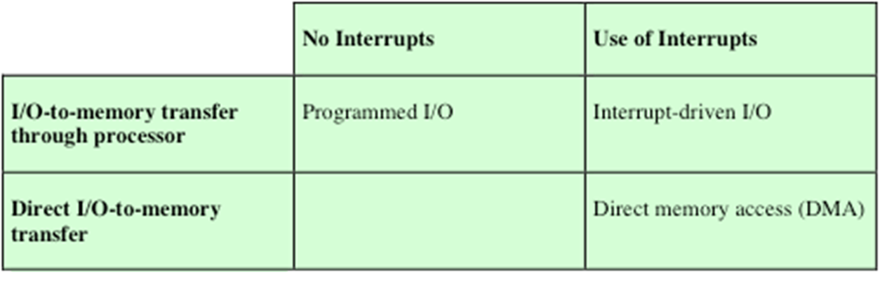
I/O Techniques

Slide 38
I/O Commands
There are four types of I/O commands that an I/O module may receive when it is addressed by a processor:
Control
  - used to activate a peripheral and tell it what to do
Test
  - used to test various status conditions associated with an I/O module and its peripherals
Read
  - causes the I/O module to obtain an item of data from the peripheral and place it in an internal buffer
Write
  - causes the I/O module to take an item of data from the data bus and subsequently transmit that data item to the peripheral

Slide 39
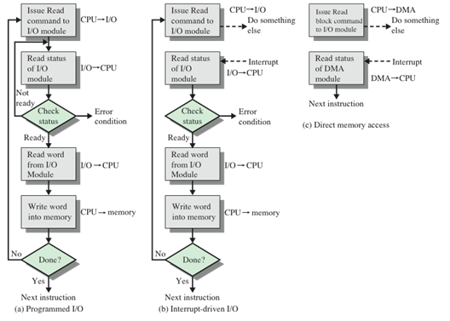
3 Techniques for Input of a Block of data

Slide 40
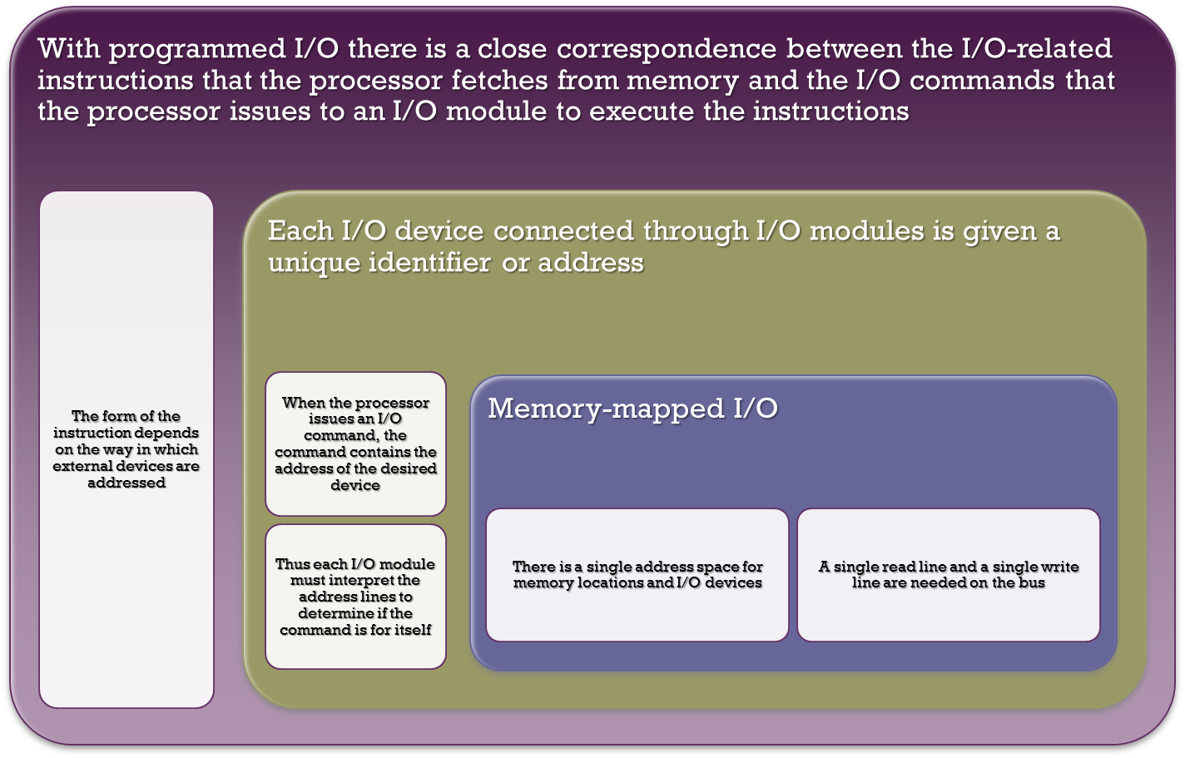
I/O Instructions
Notes:
With programmed I/O, there is a close correspondence between the I/O-related
instructions that the processor fetches from memory and the I/O commands that the
processor issues to an I/O module to execute the instructions. That is, the instructions
are easily mapped into I/O commands, and there is often a simple one-
to-one relationship. The form of the instruction depends on the way in which external
devices are addressed.
Typically, there will be many I/O devices connected through I/O modules to
the system. Each device is given a unique identifier or address. When the processor
issues an I/O command, the command contains the address of the desired device.
Thus, each I/O module must interpret the address lines to determine if the command
is for itself.
When the processor, main memory, and I/O share a common bus, two modes
of addressing are possible: memory mapped and isolated. With memory-mapped
I/O, there is a single address space for memory locations and I/O devices. The processor
treats the status and data registers of I/O modules as memory locations and
uses the same machine instructions to access both memory and I/O devices. So, for
example, with 10 address lines, a combined total of 2¹⁰ = 1024 memory locations
and I/O addresses can be supported, in any combination.
With memory-mapped I/O, a single read line and a single write line are needed
on the bus. Alternatively, the bus may be equipped with memory read and write
plus input and output command lines. Now, the command line specifies whether the
address refers to a memory location or an I/O device. The full range of addresses
may be available for both. Again, with 10 address lines, the system may now support
both 1024 memory locations and 1024 I/O addresses. Because the address space for
I/O is isolated from that for memory, this is referred to as isolated I/O.

Slide 41
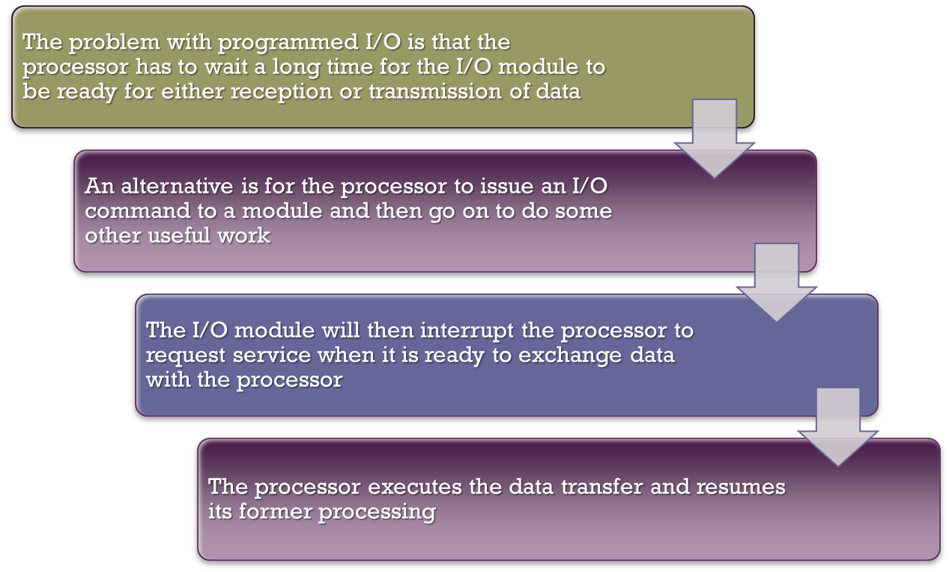
Interrupt-Driven I/O

Slide 42
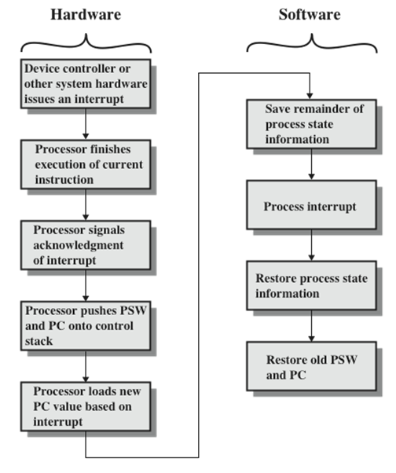
Simple Interrupt Processing

Slide 43
Direct Memory Access (DMA)
Direct Memory Access (DMA) transfers the block of data between the memory and peripheral devices of the system, without the participation of the processor.

Slide 44
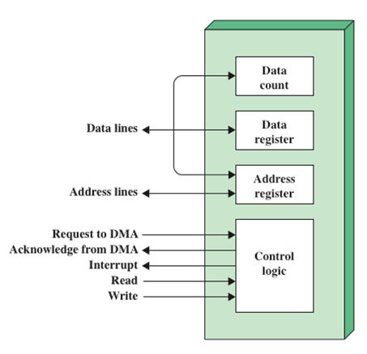
Typical DMA Block Diagram

